Slide 1
Self-supervision, BERT, and Beyond
Building Transformer-Based Natural Language Processing Applications (Part 2)

Slide 2
FULL COURSE AGENDA
Part 1: Machine Learning in NLP Lecture: NLP background and the role of DNNs leading to the Transformer architecture Lab: Tutorial-style exploration of a translation task using the Transformer architecture
Part 2: Self-Supervision, BERT, and Beyond Lecture: Discussion of how language models with self-supervision have moved beyond the basic Transformer to BERT and ever larger models Lab: Practical hands-on guide to the NVIDIA NeMo API and exercises to build a text classification task and a named entity recognition task using BERT-based language models
Part 3: Production Deployment Lecture: Discussion of production deployment considerations and NVIDIA Triton Inference Server Lab: Hands-on deployment of an example question answering task to NVIDIA Triton

Slide 3
Part 2: Self-Supervision, BERT and Beyond
Lecture
Why Do DNNs Work Well?
Self-Supervised Learning
BERT
Lab
Explore the Data
Explore NeMo
Text Classifier Project
Lecture (cont’d)
Bigger is Better
Can and should we go even bigger?
Lab (cont’d)
Named Entity Recognizer

Slide 4
Part 2: Self-Supervision, BERT and Beyond
Lecture
Why Do DNNs Work Well?
Self-Supervised Learning
BERT
Lab
Explore the Data
Explore NeMo
Text Classifier Project
Lecture (cont’d)
Bigger is Better
Can and should we go even bigger?
Lab (cont’d)
Named Entity Recognizer

Slide 5
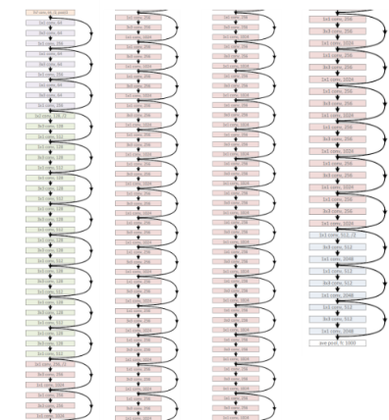
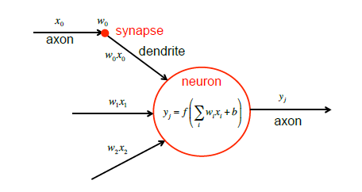
Neural Networks are Not New
They are surprisingly simple as an algorithm
Notes:
This is a set of slides explains:
Why Neural Networks did not work in the past but work now
Why majority of interesting problems require scale
The flow:
Neural networks are not new, first theorized in the 1940s, first implementation in the 1950s.
Backpropagation algorithms used to train large modern models existed in the 1980s.
Relatively simple in comparison to many alternative machine learning algorithms
Input data and passes through the neuron by multiplying the data by a set of weights/numbers, adding a set of numbers / biases, and applying a simple non linear function to the result.
Stack the resulting logic up.
Why do we see the progress in translation, self driving cars, natural language processing, and many more only now?
Next slide

Slide 6
Neural Networks are Not New
They just historically never worked well
Accuracy
Dataset Size
Andrew Ng, “Nuts and Bolts of Applying Deep Learning”, https://www.youtube.com/watch?v=F1ka6a13S9I
Notes:
Neural networks historically worked poorly compared to alternative machine learning algorithms.
Support Vector machine shifted the interest away from neural networks for almost two decades.
Why did neural networks underperform?
Small data sets meant reduced accuracy (see diagram above
More training data → better accuracy
True for all learning algorithms, eg, simple linear regression (fitting a straight line to a set of points) or neural networks
Increasing the amount of training data provided to the machine learning algorithm improves accuracy, but the gain is asymptotic
Next slide.

Slide 7
Neural Networks are Not New
They just historically never worked well
Accuracy
Dataset Size
Andrew Ng, “Nuts and Bolts of Applying Deep Learning”, https://www.youtube.com/watch?v=F1ka6a13S9I
Notes:
Historically, the only way of overcoming this property of machine learning algorithms was either though new algorithm development (very uncommon) but more importantly through feature engineering. For the last couple of decades scientists in literally all of the AI fields, so vision, natural language processing, etc. were investing huge amounts of effort to develop new and ingenious methods of representing the data to make the problem easier for the machine learning algorithms. They were effectively injecting their human knowledge about the problem to make it easier for the algorithm. As they did that they managed to systematically move this curve upwards.
That was and to large extent is still the foundation of the machine learning research.

Slide 8
Neural Networks are Not New
They just historically never worked well
Accuracy
Dataset Size
Andrew Ng, “Nuts and Bolts of Applying Deep Learning”, https://www.youtube.com/watch?v=F1ka6a13S9I
Notes:
The neural network, which did not take advantage of the manually engineered features (or took advantage of it to a limited extent) performed really badly in comparison.
The reasons for that behaviour are now obvious and boil down to three factors.
Next slide

Slide 9

Neural Networks are Not New
Historically, we never had large datasets or computers
The MNIST (1999) database contains 60,000 training images and 10,000 testing images.
Accuracy
Dataset Size
Andrew Ng, “Nuts and Bolts of Applying Deep Learning”, https://www.youtube.com/watch?v=F1ka6a13S9I
Notes:
First of all: we never had internet / Big Data scale datasets in our history. The picture on the left represents the state of the art dataset used in vision research in 1990s. 60 thousands hand written digits. Black and white, 24 by 24 pixels.
Secondly even if substantially larger datasets were available we did not have the computational capability to train neural networks with them.
Next slide

Slide 10
Compute
Historically, we never had large datasets or computers
10⁷
GPU-Computing perf
1.5X per year
1000X
By 2025
10⁶
10⁵
Transistors (thousands)
1.1X per year
10⁴
10³
1.5X per year
10²
Single-threaded perf
Notes:
Fortunately, for the last several decades we have benefited from almost an exponential increase in computational performance. Even though that trend for classical CPU computing clearly is coming to an end, because of the progress in GPU computing we can still benefit from that exponential relationship.

Slide 11
Context

Slide 12
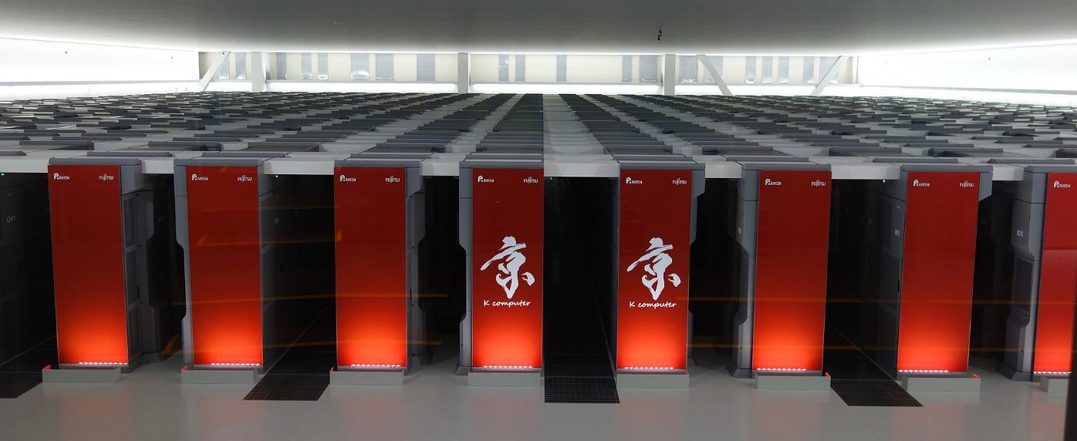
Context
8 petaFLOPs in June 2011 (K Computer)
Notes:
In November 2009 Jaguar system illustrated above constituted the world’s most performant supercomputing cluster and delivered 1.759 PetaFLOPS (that is 10^15 floating point operations per second).

Slide 13
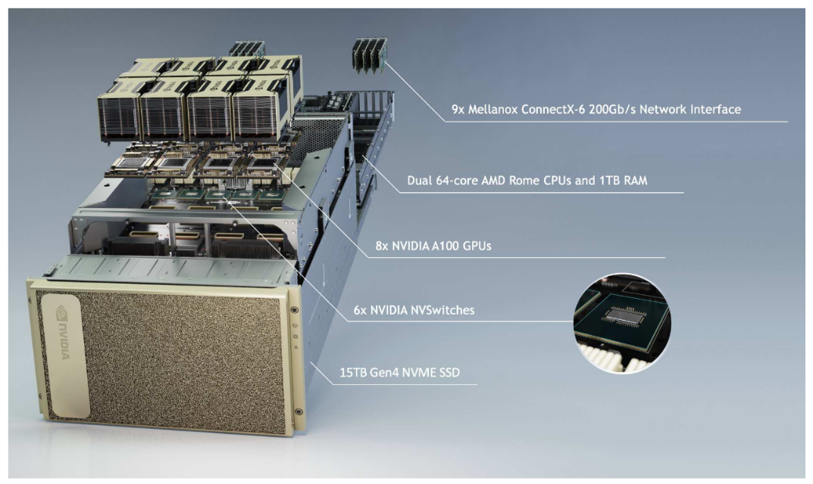
Context
5 petaFLOPs for AI - today
Notes:
Today a single system delivers 2 peta FLOPs for training neural networks.
Computational power accessible only to world’s largest superpowers in November 2009 is now available to everyone due to presence of dense GPU systems in the cloud.
Next slide

Slide 14
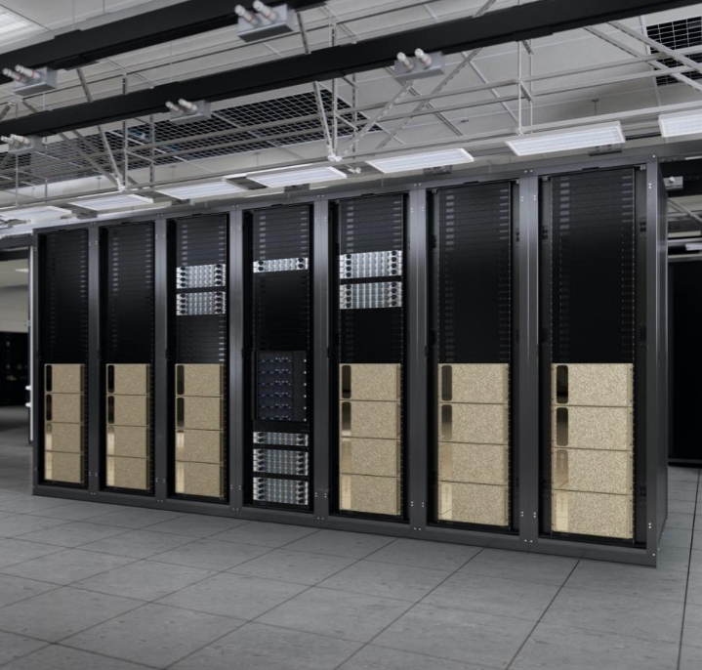
Context
~100 PFLOPS (FP16) or 48 PFLOPS (TF32) for AI - today
Notes:
Today a single system delivers 2 peta FLOPs for training neural networks.
Computational power accessible only to world’s largest superpowers in November 2009 is now available to everyone due to presence of dense GPU systems in the cloud.
Next slide

Slide 15
Neural Networks are Not New
Large datasets and faster compute transformed the way we do machine learning
Accuracy
Dataset Size
Andrew Ng, “Nuts and Bolts of Applying Deep Learning”, https://www.youtube.com/watch?v=F1ka6a13S9I
Notes:
To summarise, the increase in the size of available datasets, the decrease in the cost of compute as well as the improvement in algorithm design which allowed us to use really large neural networks led to a situation where neural networks started outperforming classical machine learning approaches and very significantly as well.
The Top 5 error in ImageNet competition dropped from 26% in 2011 to 16% in 2012. That is important as not only this is a very substantial difference but more importantly increasing the performance is no longer dependant on feature engineering. Instead is a function of model and dataset size.

Slide 16
Neural Networks are Not New
Data and model size the key to accuracy
Accuracy
Dataset Size
Notes:
Now as the model sizes increase together with datasets we see the continuation of this trend. In 2015 we have seen that error to decrease further to 3.5% and to 2.25% in 2017 significantly exceeding human performance on this dataset.
As we have learned not only the neural networks benefits more from a larger dataset but more importantly we can now move our curve upwards by increasing the complexity/size of our model.

Slide 17




Neural Network complexity is Exploding
To Tackle Increasingly Complex Challenges
7 ExaFLOPS
60 Million Parameters
20 ExaFLOPS
300 Million Parameters
100 ExaFLOPS
8700 Million Parameters
2015 – Microsoft ResNet
Superhuman Image Recognition
2016 – Baidu Deep Speech 2
Superhuman Voice Recognition
2017 – Google Neural Machine Translation
Near Human Language Translation
Notes:
Training large networks was impossible until 2015-16
Made possible by techniques such as batch normalization
Size matters
Larger neural networks more accurate
However, neural network complexity also increases
Increasing data sets + complexity requires vastly more compute power.
Example: Google Translate parameter size > 9 billion entries, requires 100 ExaFlops
Next slide

Slide 18
100 ExaFLOPs ~= 2 years on a dual CPU server

Slide 19
Neural Networks are Not New
Exceeding human level performance
Accuracy
Dataset Size
Andrew Ng, “Nuts and Bolts of Applying Deep Learning”, https://www.youtube.com/watch?v=F1ka6a13S9I
Notes:
This trend continued across other disciplines and we have observed systematically, human level performance exceeded for a wider and wider set of tasks.
But until 2017 we had very little understanding about the exact nature of this relationship between dataset size and accuracy.

Slide 20
Empirical evidence

Slide 21
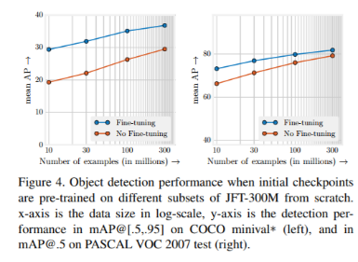
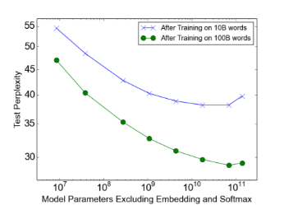
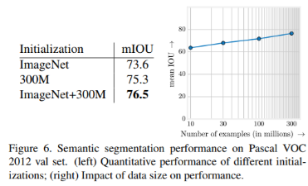
Exploding Datasets
Logarithmic relationship between the dataset size and accuracy
Sun, Chen, et al. "Revisiting Unreasonable Effectiveness of Data in Deep Learning Era." arXiv preprint arXiv:1707.02968 (2017).
Shazeer, Noam, et al. "Outrageously large neural networks: The sparsely-gated mixture-of-experts layer." arXiv preprint arXiv:1701.06538 (2017).
Simonyan, Karen, and Andrew Zisserman. "Very deep convolutional networks for large-scale image recognition." arXiv preprint arXiv:1409.1556 (2014).

Slide 22
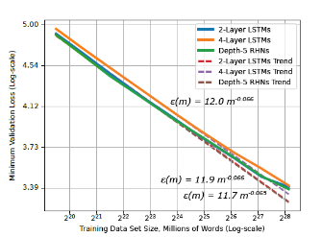
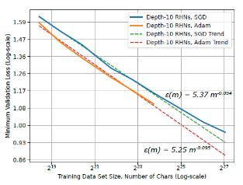
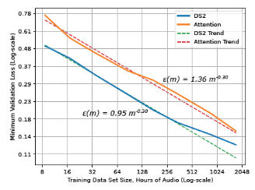
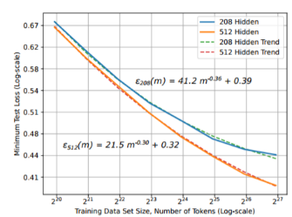
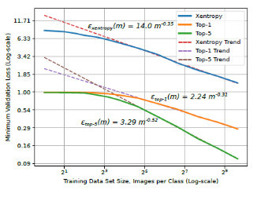
Exploding Datasets
Logarithmic relationship between the dataset size and accuracy
Translation
Language Models
Character Language Models
Image Classification
Attention Speech Models
Hestness, J., Narang, S., Ardalani, N., Diamos, G., Jun, H., Kianinejad, H., ... & Zhou, Y. (2017). Deep Learning Scaling is Predictable, Empirically. arXiv preprint arXiv:1712.00409.

Slide 23
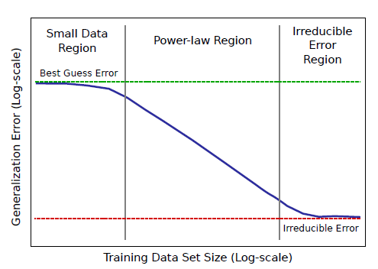
Exploding Datasets
Logarithmic relationship between the dataset size and accuracy
Hestness, J., Narang, S., Ardalani, N., Diamos, G., Jun, H., Kianinejad, H., ... & Zhou, Y. (2017). Deep Learning Scaling is Predictable, Empirically. arXiv preprint arXiv:1712.00409.

Slide 24
The Cost

Slide 25
The cost of Labeling
Limits the utility of deep learning models
Exponential increase
Hestness, J., Narang, S., Ardalani, N., Diamos, G., Jun, H., Kianinejad, H., ... & Zhou, Y. (2017). Deep Learning Scaling is Predictable, Empirically. arXiv preprint arXiv:1712.00409.

Slide 26
Part 2: Self-Supervision, BERT and Beyond
Lecture
Why Do DNNs Work Well?
Self-Supervised Learning
BERT
Lab
Explore the Data
Explore NeMo
Text Classifier Project
Lecture (cont’d)
Bigger is Better
Can and should we go even bigger?
Lab (cont’d)
Named Entity Recognizer

Slide 27
Self-Supervised Learning
Example training tasks
Natural Language Processing:
Masked Language Model: We mask a percentage of the input tokens at random (say 15%) and ask the neural network to predict the entire sentence
Next Sentence Prediction: We choose either two consecutive sentences from text, or two random sentences from the text. We ask the neural network to establish whether the two sentences occur one after another.
We use another simpler neural network to replace random words in the sequence and ask the primary neural network to detect which words were replaced (using a GAN like configuration).
Computer Vision:
Contrastive Learning: Randomly modify (crop and resize, flip, distort color, rotate, cut-out, noise, blur, etc.) and either feed the same image, or two randomly selected images, into the neural network, asking it to say whether it is the same image or not
Noisy labels/Self Training: Use labels generated by a weak algorithm (potentially older generation of the target model) to train a target-robust feature extractor
Dai, A. M., & Le, Q. V. (2015). Semi-supervised sequence learning. In Advances in neural information processing systems (pp. 3079-3087).
Chen, T., Kornblith, S., Norouzi, M., & Hinton, G. (2020). A simple framework for contrastive learning of visual representations. arXiv preprint arXiv:2002.05709.
Xie, Q., Hovy, E., Luong, M. T., & Le, Q. V. (2019). Self-training with Noisy Student improves ImageNet classification. arXiv preprint arXiv:1911.04252.

Slide 28
The cost of labeling
Semi-supervised models
Manageable cost
Hestness, J., Narang, S., Ardalani, N., Diamos, G., Jun, H., Kianinejad, H., ... & Zhou, Y. (2017). Deep Learning Scaling is Predictable, Empirically. arXiv preprint arXiv:1712.00409.

Slide 29



SeLF-supervised learning
Abundance of unlabeled data

Slide 30
SeLF-supervised learning
Abundance of unlabeled data

Slide 31
Old Ideas

Slide 32
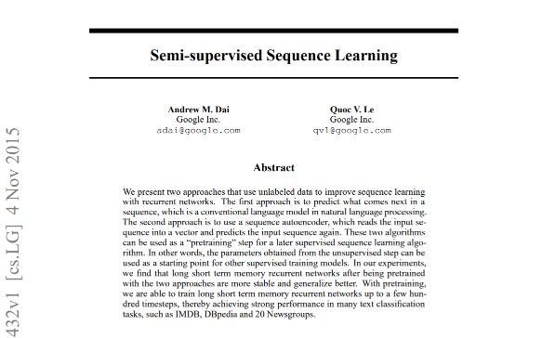
Self-Supervised Learning
What was missing?

Slide 33
The Scale

Slide 34
Generative Pretraining (GPT)
The scale
“Many previous approaches to NLP tasks train relatively small models on a single GPU from scratch. Our approach requires an expensive pre-training step - 1 month on 8 GPUs. Luckily, this only has to be done once and we’re releasing our model so others can avoid it. It is also a large model (in comparison to prior work) and consequently uses more compute and memory — we used a 37-layer (12 block) Transformer architecture, and we train on sequences of up to 512 tokens. Most experiments were conducted on 4 and 8 GPU systems. The model does fine-tune to new tasks very quickly which helps mitigate the additional resource requirements.”
Radford, A., Narasimhan, K., Salimans, T., & Sutskever, I. (2018). Improving language understanding by generative pre-training. URL https://s3-us-west-2. amazonaws. com/openai-assets/researchcovers/languageunsupervised/language understanding paper. pdf.

Slide 35
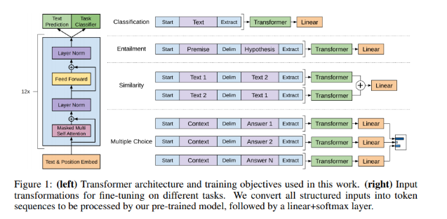
Generative Pretraining (GPT)
The design
Transformer
Decoder
Self-Supervised
Training
Radford, A., Narasimhan, K., Salimans, T., & Sutskever, I. (2018). Improving language understanding by generative pre-training. URL https://s3-us-west-2. amazonaws. com/openai-assets/researchcovers/languageunsupervised/language understanding paper. pdf.

Slide 36
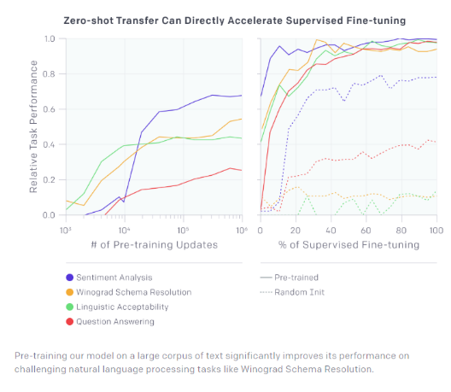
Generative Pretraining (GPT)
The approach
Step 1
Step 2
Radford, A., Narasimhan, K., Salimans, T., & Sutskever, I. (2018). Improving language understanding by generative pre-training. URL https://s3-us-west-2. amazonaws. com/openai-assets/researchcovers/languageunsupervised/language understanding paper. pdf.

Slide 37
Generative Pretraining (GPT)
The implications
Radford, A., Narasimhan, K., Salimans, T., & Sutskever, I. (2018). Improving language understanding by generative pre-training. URL https://s3-us-west-2. amazonaws. com/openai-assets/researchcovers/languageunsupervised/language understanding paper. pdf.

Slide 38
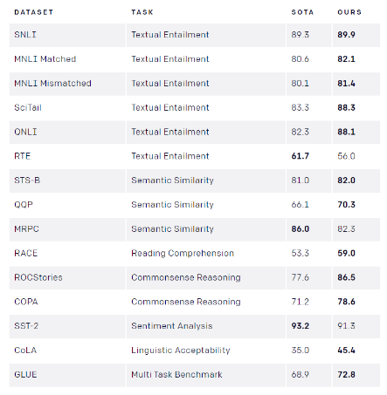
Generative Pretraining (GPT)
The implications
Radford, A., Narasimhan, K., Salimans, T., & Sutskever, I. (2018). Improving language understanding by generative pre-training. URL https://s3-us-west-2. amazonaws. com/openai-assets/researchcovers/languageunsupervised/language understanding paper. pdf.

Slide 39
Part 2: Self-Supervision, BERT and Beyond
Lecture
Why Do DNNs Work Well?
Self-Supervised Learning
BERT
Lab
Explore the Data
Explore NeMo
Text Classifier Project
Lecture (cont’d)
Bigger is Better
Can and should we go even bigger?
Lab (cont’d)
Named Entity Recognizer

Slide 40
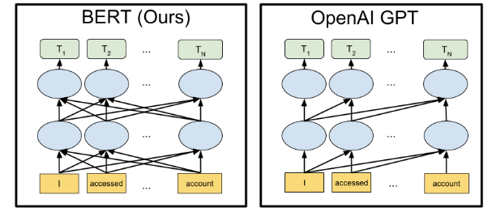
Bidirectional Transformers (BERT)
Building on the shoulders of giants
Devlin, J., Chang, M. W., Lee, K., & Toutanova, K. (2018). Bert: Pre-training of deep bidirectional transformers for language understanding. arXiv preprint arXiv:1810.04805.

Slide 41
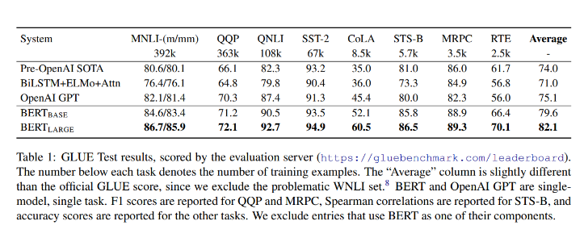
Bidirectional Transformers (BERT)
The “pre” and “post” OpenAI ages
Devlin, J., Chang, M. W., Lee, K., & Toutanova, K. (2018). Bert: Pre-training of deep bidirectional transformers for language understanding. arXiv preprint arXiv:1810.04805.

Slide 42
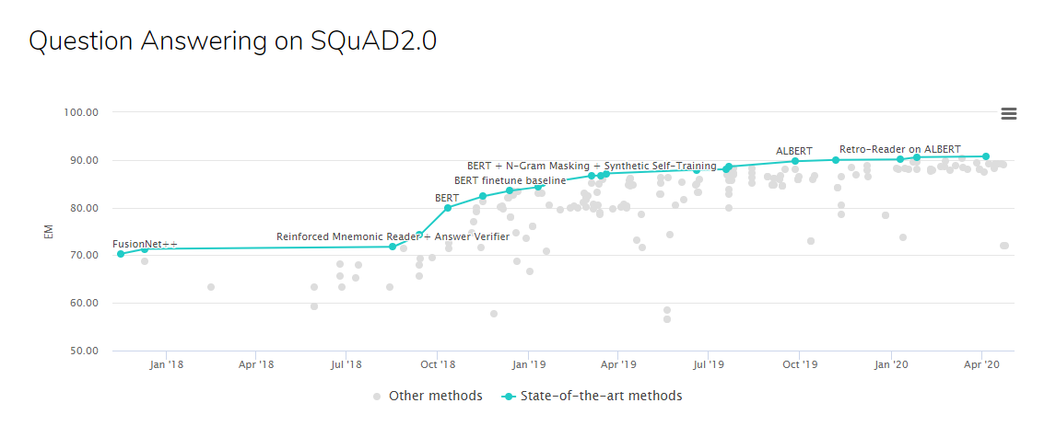
SQUAD 2.0
Human performance 91.2

Slide 43
Using BERT
Feature extractor
?
Problem formulation
?
?
?
?
?
?
Machine Learning Algorithm
Text Pre-processing
Text Representation
Reweighting
Dimensionality Reduction
Vector Comparison
Text
GloVe
Word2Vec
BERT

Slide 44
The Lab

Slide 45
Lab Overview
Notebooks 1, 2, 3
Text classification
Problem formulation
Machine Learning Algorithm
Text Pre-processing
Text Representation
Reweighting
Dimensionality Reduction
Vector Comparison
Text
Your task:
Text classification
Fixed pretrained BERT

Slide 46
Part 2: Self-Supervision, BERT and Beyond
Lecture
Why Do DNNs Work Well?
Self-Supervised Learning
BERT
Lab
Explore the Data
Explore NeMo
Text Classifier Project
Lecture (cont’d)
Bigger is Better
Can and should we go even bigger?
Lab (cont’d)
Named Entity Recognizer

Slide 47
Part 2: Self-Supervision, BERT and Beyond
Lecture
Why Do DNNs Work Well?
Self-Supervised Learning
BERT
Lab
Explore the Data
Explore NeMo
Text Classifier Project
Lecture (cont’d)
Bigger is Better
Can and should we go even bigger?
Lab (cont’d)
Named Entity Recognizer

Slide 48
Bidirectional Transformers (BERT)
Base vs Large
Devlin, J., Chang, M. W., Lee, K., & Toutanova, K. (2018). Bert: Pre-training of deep bidirectional transformers for language understanding. arXiv preprint arXiv:1810.04805.

Slide 49
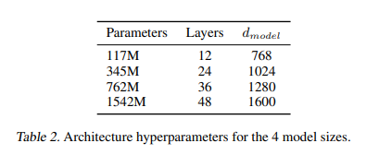
GPT-2
GPT vs GPT-2
Largely the same but:
Larger in every way:
More decoder layers: 12->48
Larger vocabulary: 50,257
Larger context: 512 -> 1024
Larger batch size
Changes to layer normalization
Different initialization scheme
Radford, A., Wu, J., Child, R., Luan, D., Amodei, D., & Sutskever, I. (2019). Language models are unsupervised multitask learners. OpenAI Blog, 1(8), 9.

Slide 50
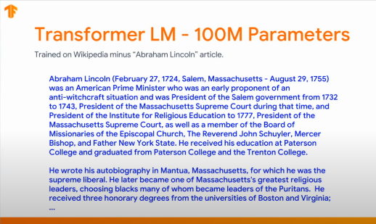
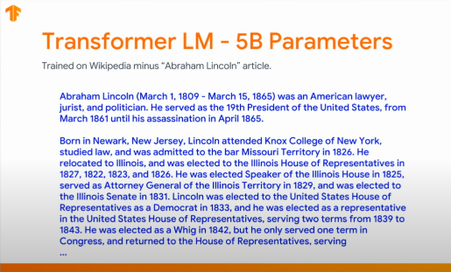
GPT-2
The Impact
Radford, A., Wu, J., Child, R., Luan, D., Amodei, D., & Sutskever, I. (2019). Language models are unsupervised multitask learners. OpenAI Blog, 1(8), 9.

Slide 51
But Bigger is better

Slide 52
Roberta
Robustly Optimized BERT Pretraining Approach
Simplification of the core idea:
training the model longer, with bigger batches, over more data
removing the next sentence prediction objective
training on longer sequences
dynamically changing the masking pattern applied to the training data
Liu, Y., Ott, M., Goyal, N., Du, J., Joshi, M., Chen, D., ... & Stoyanov, V. (2019). Roberta: A robustly optimized bert pretraining approach. arXiv preprint arXiv:1907.11692.

Slide 53
Roberta
Increasing the dataset size
16GB -> 160GB
Liu, Y., Ott, M., Goyal, N., Du, J., Joshi, M., Chen, D., ... & Stoyanov, V. (2019). Roberta: A robustly optimized bert pretraining approach. arXiv preprint arXiv:1907.11692.

Slide 54
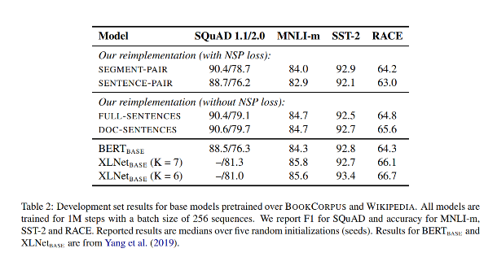
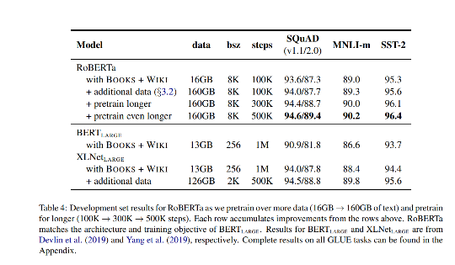
RoBerta
Results
Liu, Y., Ott, M., Goyal, N., Du, J., Joshi, M., Chen, D., ... & Stoyanov, V. (2019). Roberta: A robustly optimized bert pretraining approach. arXiv preprint arXiv:1907.11692.

Slide 55
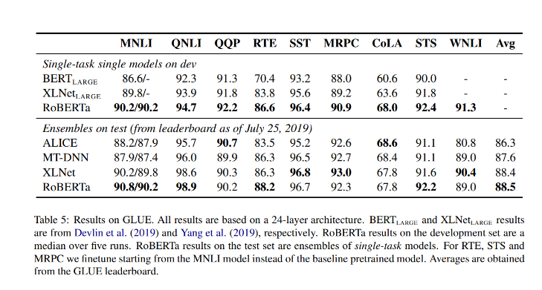
RoBerta
Results
Liu, Y., Ott, M., Goyal, N., Du, J., Joshi, M., Chen, D., ... & Stoyanov, V. (2019). Roberta: A robustly optimized bert pretraining approach. arXiv preprint arXiv:1907.11692.

Slide 56
Roberta
Additional observations
“We note that even our longest-trained model does not appear to overfit our data and would likely benefit from additional training.“
Liu, Y., Ott, M., Goyal, N., Du, J., Joshi, M., Chen, D., ... & Stoyanov, V. (2019). Roberta: A robustly optimized bert pretraining approach. arXiv preprint arXiv:1907.11692.

Slide 57
We need even larger models!

Slide 58
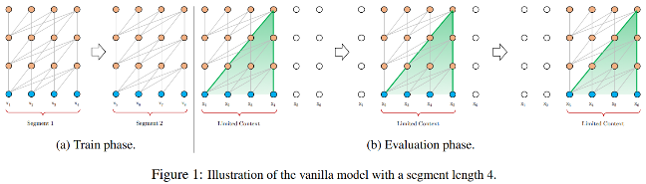
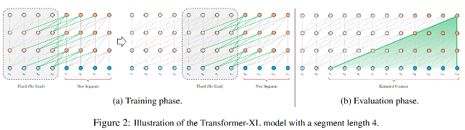
Transformer Extra Long (XL)
Challenges with the Transformer architecture
The challenge:
Fixed-length contexts not respecting semantic boundaries
Inability to learn longer dependencies
Relatively slow to execute
The solution (Transformer XL):
Segment-level recurrence mechanism
Positional encoding scheme
The results:
Learns 80% longer dependencies than RNNs and 450% longer than Transformer
Up to 1800 times faster than vanilla Transformer
Dai, Z., Yang, Z., Yang, Y., Carbonell, J., Le, Q. V., & Salakhutdinov, R. (2019). Transformer-xl: Attentive language models beyond a fixed-length context. arXiv preprint arXiv:1901.02860.

Slide 59
Challenges with BERT
Masking and independent predictions
The [MASK] token used during pretraining is not used during fine-tuning
BERT generates predictions for individual [MASK] tokens independently, not forcing the model to learn dependencies
Yang, Z., Dai, Z., Yang, Y., Carbonell, J., Salakhutdinov, R. R., & Le, Q. V. (2019). Xlnet: Generalized autoregressive pretraining for language understanding. In Advances in neural information processing systems (pp. 5754-5764).

Slide 60
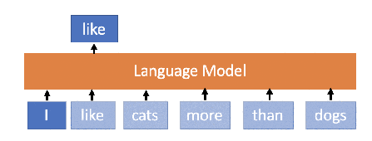
XLNet
TransformerXL + Permutational Language Model
Transformer -> TransformerXL
TransformerXL cannot be applied naively and must be adopted
“Maximizes the expected log likelihood of a sequence w.r.t all possible permutations of the factorization order.”
Does not rely on data corruption ([MASK])
Yang, Z., Dai, Z., Yang, Y., Carbonell, J., Salakhutdinov, R. R., & Le, Q. V. (2019). Xlnet: Generalized autoregressive pretraining for language understanding. In Advances in neural information processing systems (pp. 5754-5764).
https://mlexplained.com/2019/06/30/paper-dissected-xlnet-generalized-autoregressive-pretraining-for-language-understanding-explained/

Slide 61
XLNet
And more data
13GB* -> 13GB + 19GB + 110GB = 142GB
* Different pre-processing routine is used hence not 16GB as per ROBERTA
Yang, Z., Dai, Z., Yang, Y., Carbonell, J., Salakhutdinov, R. R., & Le, Q. V. (2019). Xlnet: Generalized autoregressive pretraining for language understanding. In Advances in neural information processing systems (pp. 5754-5764).

Slide 62
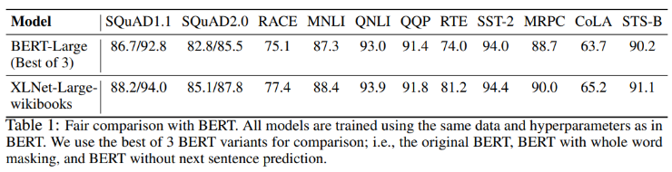
XLNET
“Fair” comparison with BERT
Yang, Z., Dai, Z., Yang, Y., Carbonell, J., Salakhutdinov, R. R., & Le, Q. V. (2019). Xlnet: Generalized autoregressive pretraining for language understanding. In Advances in neural information processing systems (pp. 5754-5764).

Slide 63
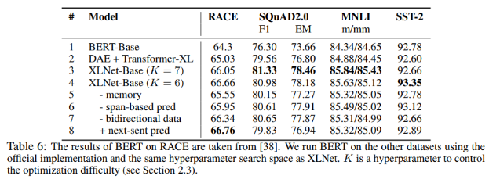
XLNET
Ablation study
Yang, Z., Dai, Z., Yang, Y., Carbonell, J., Salakhutdinov, R. R., & Le, Q. V. (2019). Xlnet: Generalized autoregressive pretraining for language understanding. In Advances in neural information processing systems (pp. 5754-5764).

Slide 64
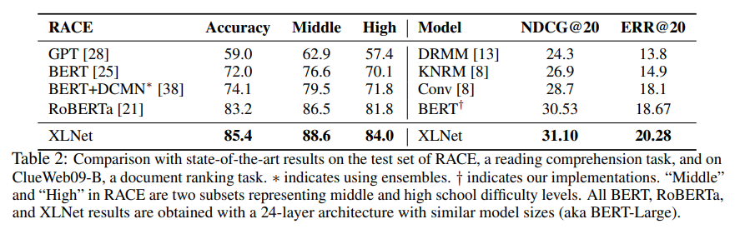
XLNET
Scaling up
Yang, Z., Dai, Z., Yang, Y., Carbonell, J., Salakhutdinov, R. R., & Le, Q. V. (2019). Xlnet: Generalized autoregressive pretraining for language understanding. In Advances in neural information processing systems (pp. 5754-5764).

Slide 65
Scaling up?

Slide 66
XLNET
Scaling up
“… we scale up the training of XLNet-Large by using all the datasets described above. Specifically, we train on 512 TPU v3 chips for 500K steps with an Adam weight decay optimizer, linear learning rate decay, and a batch size of 8192, which takes about 5.5 days.”
Yang, Z., Dai, Z., Yang, Y., Carbonell, J., Salakhutdinov, R. R., & Le, Q. V. (2019). Xlnet: Generalized autoregressive pretraining for language understanding. In Advances in neural information processing systems (pp. 5754-5764).

Slide 67
XLNET
Scaling up
“It was observed that the model still underfits the data at the end of training.”
Yang, Z., Dai, Z., Yang, Y., Carbonell, J., Salakhutdinov, R. R., & Le, Q. V. (2019). Xlnet: Generalized autoregressive pretraining for language understanding. In Advances in neural information processing systems (pp. 5754-5764).

Slide 68
Scaling up?

Slide 69
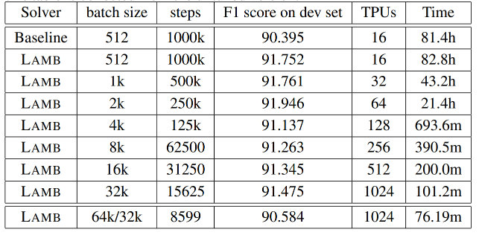
BERT
5.5 days -> 76 minutes
Inspired by NVIDIA LARS (Layer-wise Adaptive Rate Scaling) they develop LAMB
This allows to scale batch size to 32k without degrading performance
A lot of improvements introduced since. Please use NVLAMB.
https://devblogs.nvidia.com/pretraining-bert-with-layer-wise-adaptive-learning-rates/
You, Y., Li, J., Reddi, S., Hseu, J., Kumar, S., Bhojanapalli, S., ... & Hsieh, C. J. (2019, September). Large batch optimization for deep learning: Training bert in 76 minutes. In International Conference on Learning Representations.

Slide 70
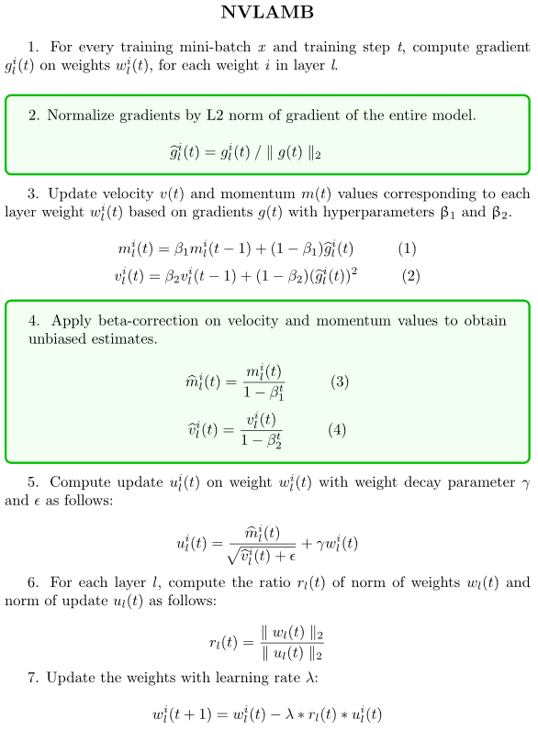

BERT
5.5 days -> 76 minutes
Inspired by NVIDIA LARS (Layer-wise Adaptive Rate Scaling) they develop LAMB
This allows to scale batch size to 32k without degrading performance
A lot of improvements introduced since. Please use NVLAMB.
https://devblogs.nvidia.com/pretraining-bert-with-layer-wise-adaptive-learning-rates/
You, Y., Li, J., Reddi, S., Hseu, J., Kumar, S., Bhojanapalli, S., ... & Hsieh, C. J. (2019, September). Large batch optimization for deep learning: Training bert in 76 minutes. In International Conference on Learning Representations.

Slide 71
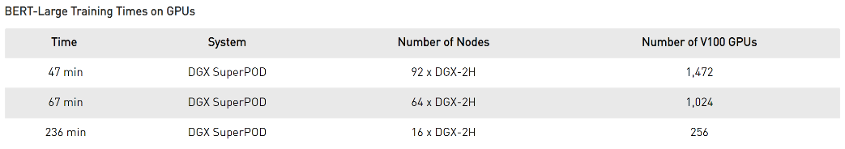
BERT
Fastest training time
https://devblogs.nvidia.com/training-bert-with-gpus/

Slide 72
CAN we use Parameters more efficiently?

Slide 73
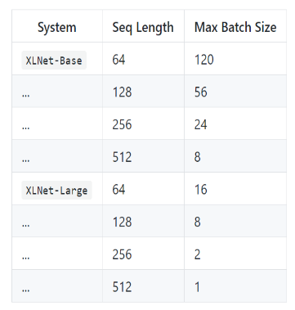
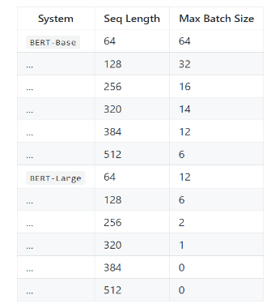
ALBERT
A Lite BERT for Self-Supervised Learning of Language Representations
FP32 TF 1.13.1 16GB GPU
FP32 TF 1.11.0 12GB GPU
The size of the model is becoming a challenge
FP16 is addressing the problem to some extent but still the footprint is considerable
Describes a set of methods for reducing the memory footprint/ improving parameter efficiency
Lan, Z., Chen, M., Goodman, S., Gimpel, K., Sharma, P., & Soricut, R. (2019). Albert: A lite bert for self-supervised learning of language representations. arXiv preprint arXiv:1909.11942.

Slide 74
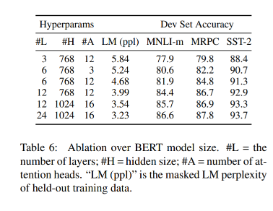
ALBERT
Model size is the key to success
Lan, Z., Chen, M., Goodman, S., Gimpel, K., Sharma, P., & Soricut, R. (2019). Albert: A lite bert for self-supervised learning of language representations. arXiv preprint arXiv:1909.11942.

Slide 75
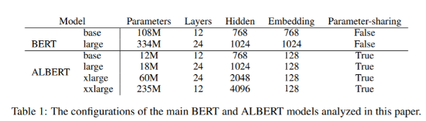

ALBERT
Factorized Embeddings
“… WordPiece embedding size E is tied with the hidden layer size H, i.e., E ≡ H”
“… hidden-layer embeddings are meant to learn context-dependent representations.” so we want H >> E
Embedding matrix size is V x E (vocabulary size time embedding size)
“… natural language processing usually requires the vocabulary size V to be large.” (BERT V=30000)
So we end up with LargeNumber x LargeNumber
Factorization of the embeddings matrix:
O(V x H) transformed into O(V x E + E x H)
Lan, Z., Chen, M., Goodman, S., Gimpel, K., Sharma, P., & Soricut, R. (2019). Albert: A lite bert for self-supervised learning of language representations. arXiv preprint arXiv:1909.11942.

Slide 76
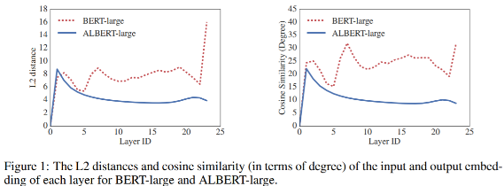
ALBERT
Cross Layer Parameter Sharing and Inter-Sentence Coherence Loss
Proposes several cross-layer parameter-sharing schemes
The default Albert configuration shares all parameters across all layers
SOP Loss (Sentence Order Prediction) rather than NSP Loss (Next Sentence Prediction)
Lan, Z., Chen, M., Goodman, S., Gimpel, K., Sharma, P., & Soricut, R. (2019). Albert: A lite bert for self-supervised learning of language representations. arXiv preprint arXiv:1909.11942.

Slide 77
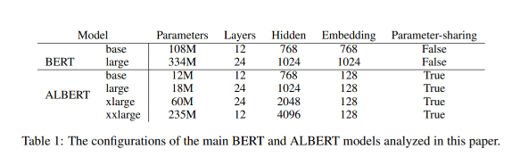
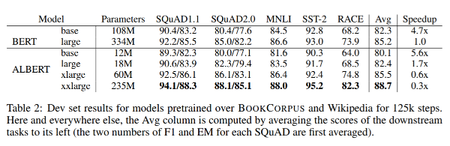
ALBERT
Results
Lan, Z., Chen, M., Goodman, S., Gimpel, K., Sharma, P., & Soricut, R. (2019). Albert: A lite bert for self-supervised learning of language representations. arXiv preprint arXiv:1909.11942.

Slide 78
Can we improve the objective function further?

Slide 79
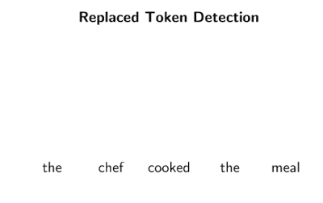
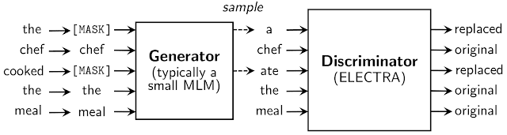
ELECTRA
Pre-training Text Encoders as Discriminators Rather Than Generators
Clark, K., Luong, M. T., Le, Q. V., & Manning, C. D. (2020). Electra: Pre-training text encoders as discriminators rather than generators. arXiv preprint arXiv:2003.10555.

Slide 80
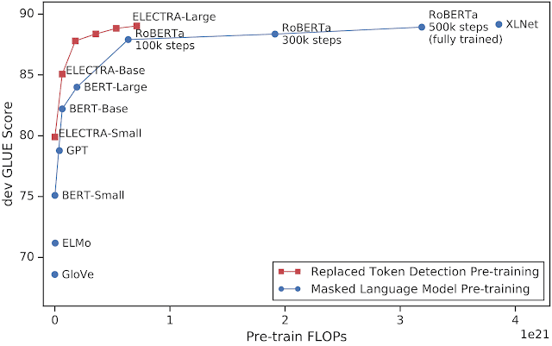
ELECTRA
Pre-training Text Encoders as Discriminators Rather Than Generators
Clark, K., Luong, M. T., Le, Q. V., & Manning, C. D. (2020). Electra: Pre-training text encoders as discriminators rather than generators. arXiv preprint arXiv:2003.10555.

Slide 81
Multi-task learning

Slide 82
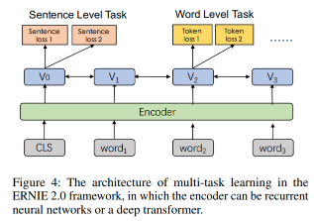
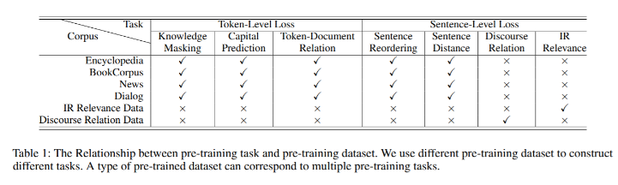
ERNIE 2.0
Why use only a limited number of simple pretraining tasks?

Slide 83
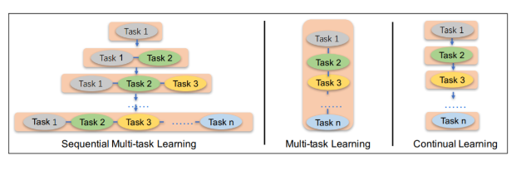
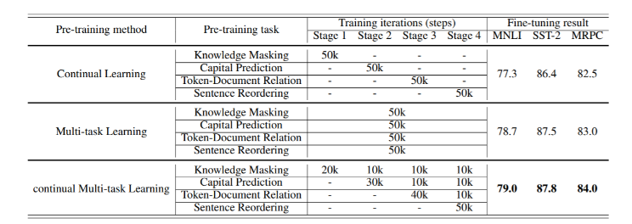
ERNIE 2.0
Why use only a limited number of simple pretraining tasks?

Slide 84

ERNIE 2.0
Performance

Slide 85
Part 2: Self-Supervision, BERT and Beyond
Lecture
Why Do DNNs Work Well?
Self-Supervised Learning
BERT
Lab
Explore the Data
Explore NeMo
Text Classifier Project
Lecture (cont’d)
Bigger is Better
Can and should we go even bigger?
Lab (cont’d)
Named Entity Recognizer

Slide 86
Going Bigger
The challenge
If we only consider Parameters, Gradients, and Optimizer states and ignore activations
If we use FP16 data representation (so two bytes)
If we use Adam as an optimizer (storing twelve bytes per parameter in mixed precision mode)
If we consider a model with one billion parameters
10^9 * ( 2B + 2B + 12B) = 10^9*16B = 14.90GB
1 billion parameters
2 bytes per gradient
2 bytes per parameter
12 bytes per optimizer state

Slide 87
Going Bigger
The challenge
What about activations?
What about 2 or 3 billion parameter models?
10^9 * ( 2B + 2B + 12B) = 10^9*16B = 14.90GB
1 billion parameters
2 bytes per gradient
2 bytes per parameter
12 bytes per optimizer state

Slide 88


Megatron
Model Parallel Transformer
Shoeybi, M., Patwary, M., Puri, R., LeGresley, P., Casper, J., & Catanzaro, B. (2019). Megatron-lm: Training multi-billion parameter language models using gpu model parallelism. arXiv preprint arXiv:1909.08053.

Slide 89


Megatron
76% scaling efficiency using 512 GPUs
Shoeybi, M., Patwary, M., Puri, R., LeGresley, P., Casper, J., & Catanzaro, B. (2019). Megatron-lm: Training multi-billion parameter language models using gpu model parallelism. arXiv preprint arXiv:1909.08053.

Slide 90

Megatron
Results
Shoeybi, M., Patwary, M., Puri, R., LeGresley, P., Casper, J., & Catanzaro, B. (2019). Megatron-lm: Training multi-billion parameter language models using gpu model parallelism. arXiv preprint arXiv:1909.08053.

Slide 91

Megatron
More importantly!
Shoeybi, M., Patwary, M., Puri, R., LeGresley, P., Casper, J., & Catanzaro, B. (2019). Megatron-lm: Training multi-billion parameter language models using gpu model parallelism. arXiv preprint arXiv:1909.08053.

Slide 92
The scaling laws

Slide 93

The Scaling Laws
As you increase the dataset size, you must increase the model size
Kaplan, J., McCandlish, S., Henighan, T., Brown, T. B., Chess, B., Child, R., ... & Amodei, D. (2020). Scaling Laws for Neural Language Models. arXiv preprint arXiv:2001.08361.

Slide 94


The Scaling Laws
Larger models are more sample-efficient
Kaplan, J., McCandlish, S., Henighan, T., Brown, T. B., Chess, B., Child, R., ... & Amodei, D. (2020). Scaling Laws for Neural Language Models. arXiv preprint arXiv:2001.08361.

Slide 95

The Scaling Laws
Larger models generalize better
Kaplan, J., McCandlish, S., Henighan, T., Brown, T. B., Chess, B., Child, R., ... & Amodei, D. (2020). Scaling Laws for Neural Language Models. arXiv preprint arXiv:2001.08361.

Slide 96

The Scaling Laws
Its cheaper to use a larger model
Kaplan, J., McCandlish, S., Henighan, T., Brown, T. B., Chess, B., Child, R., ... & Amodei, D. (2020). Scaling Laws for Neural Language Models. arXiv preprint arXiv:2001.08361.

Slide 97

The Scaling Laws
Larger models train faster
https://bair.berkeley.edu/blog/2020/03/05/compress/

Slide 98
The Scaling Laws
MOST IMPORTANT!!
“… more importantly, we find that the precise architectural hyperparameters are unimportant compared to the overall scale of the language model.”
Kaplan, J., McCandlish, S., Henighan, T., Brown, T. B., Chess, B., Child, R., ... & Amodei, D. (2020). Scaling Laws for Neural Language Models. arXiv preprint arXiv:2001.08361.

Slide 99

The Scaling Laws
Next two years will bring much larger models

Slide 100
Towards a trillion-parameter model

Slide 101

TuringNLG
17 billion parameters

Slide 102

The future
Towards a trillion-parameter model

Slide 103
GPT-3

Slide 104

Even more importantly
Large neural networks use data more efficiently
Shoeybi, M., Patwary, M., Puri, R., LeGresley, P., Casper, J., & Catanzaro, B. (2019). Megatron-lm: Training multi-billion parameter language models using gpu model parallelism. arXiv preprint arXiv:1909.08053
Brown, T. B., Mann, B., Ryder, N., Subbiah, M., Kaplan, J., Dhariwal, P., ... & Agarwal, S. (2020). Language models are few-shot learners. arXiv preprint arXiv:2005.14165..

Slide 105
Even more importantly
Large neural networks use data more efficiently
Shoeybi, M., Patwary, M., Puri, R., LeGresley, P., Casper, J., & Catanzaro, B. (2019). Megatron-lm: Training multi-billion parameter language models using gpu model parallelism. arXiv preprint arXiv:1909.08053
Brown, T. B., Mann, B., Ryder, N., Subbiah, M., Kaplan, J., Dhariwal, P., ... & Agarwal, S. (2020). Language models are few-shot learners. arXiv preprint arXiv:2005.14165..

Slide 106

What do We mean by big?
GPT-3 size comparison
Not a linear scale

Slide 107
Perspective

Slide 108
What do we mean by big?
Perspective

Slide 109
What do we mean by big?
Perspective

Slide 110
What do we mean by big?
Perspective

Slide 111
What do we mean by big?
Perspective

Slide 112
What do we mean by big?
GPT-3 size comparison: 538x Bigger than BERT-Large
355 years on a single V100
Not a linear scale
Notes:
Implications
Ability to efficiently collect and process large volumes of data
Ability to efficiently train large models on large volumes of data
Ability to cost effectively deploy large models

Slide 113
The lab

Slide 114
Part 2: Self-Supervision, BERT and Beyond
Lecture
Why DNNs?
Self-Supervision
BERT
Lab
Explore the Data
Explore NeMo
Text Classifier Project
Lecture (cont’d)
Bigger is Better
Can and should we go even bigger?
Lab (cont’d)
Named Entity Recognizer

Slide 115
In the Next class…

Slide 116
Next class
Overview
Discuss how to design your model for efficient inference
Discuss how to optimise your model for efficient execution
Discuss how to efficiently host a largely Conversational AI application

